Slide 1
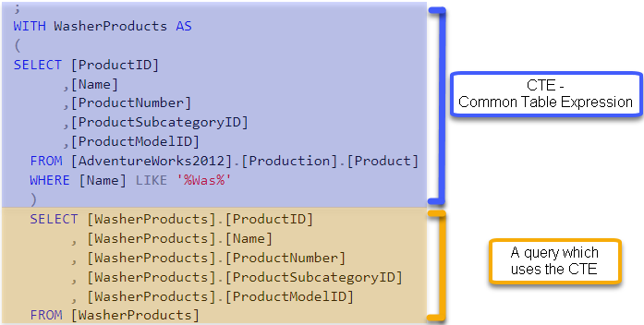

Slide 2


Slide 3
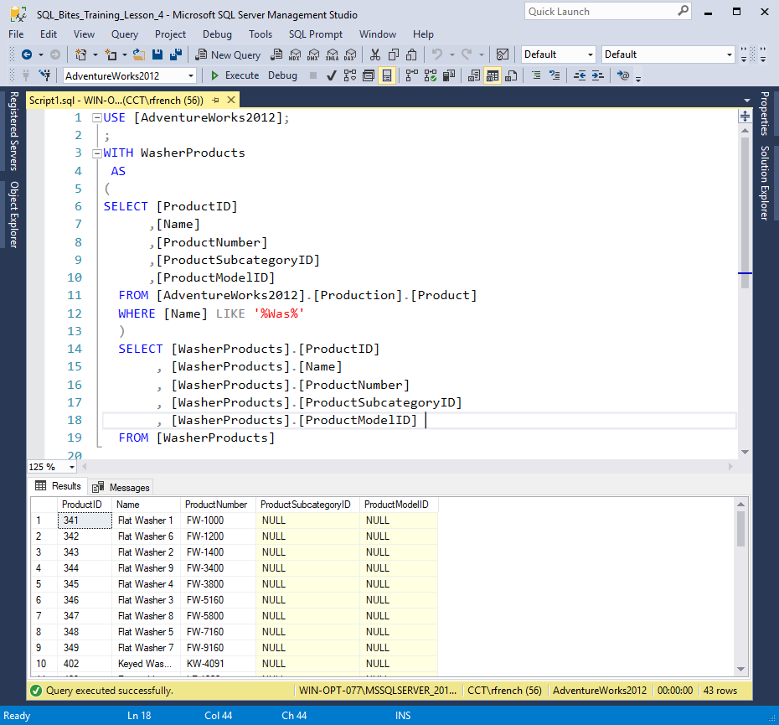
CTE version one (Figure 1)

Slide 4
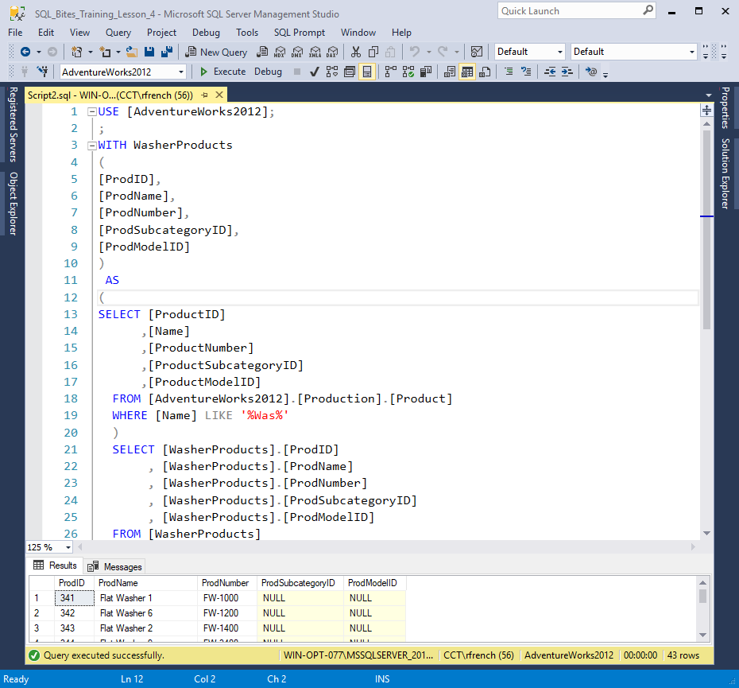
CTE version two (Figure 2)

Slide 5

Notes:
https://pixabay.com/en/important-stamp-imprint-2508600/

Slide 6


Notes:
Photo by Photos by Lanty on Unsplash

Slide 7
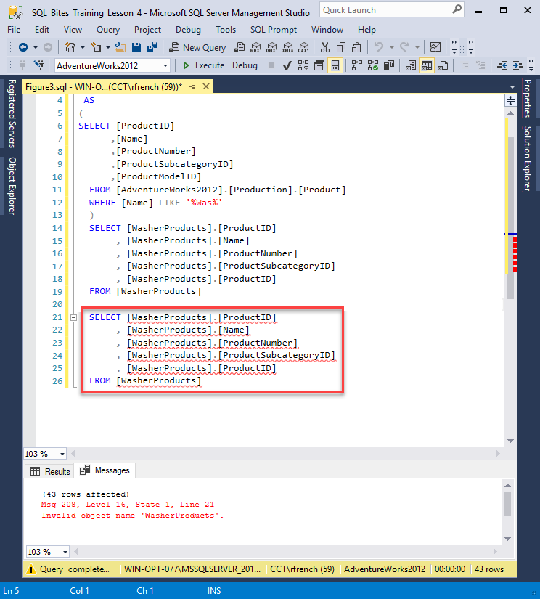
(Figure 3)

Slide 8
CTE’s what are they good for
(what can you do with them?)

Slide 9
Readability
Complexity

Slide 10
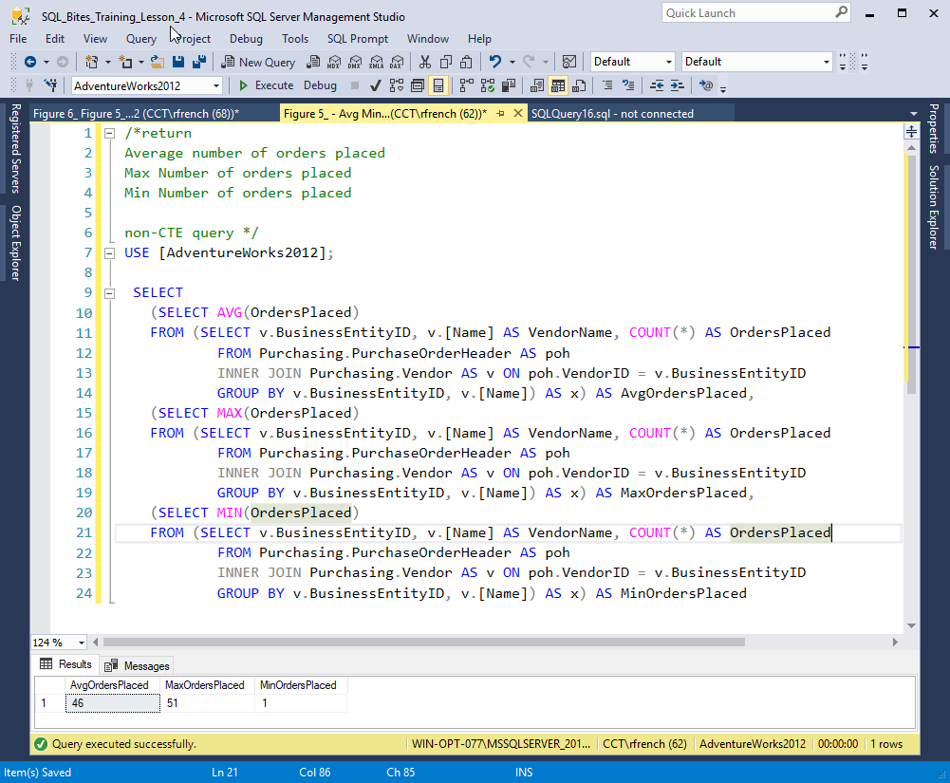
(Figure 4)
Notes:
https://facility9.com/2008/12/a-quick-introduction-to-common-table-expressions-3/

Slide 11
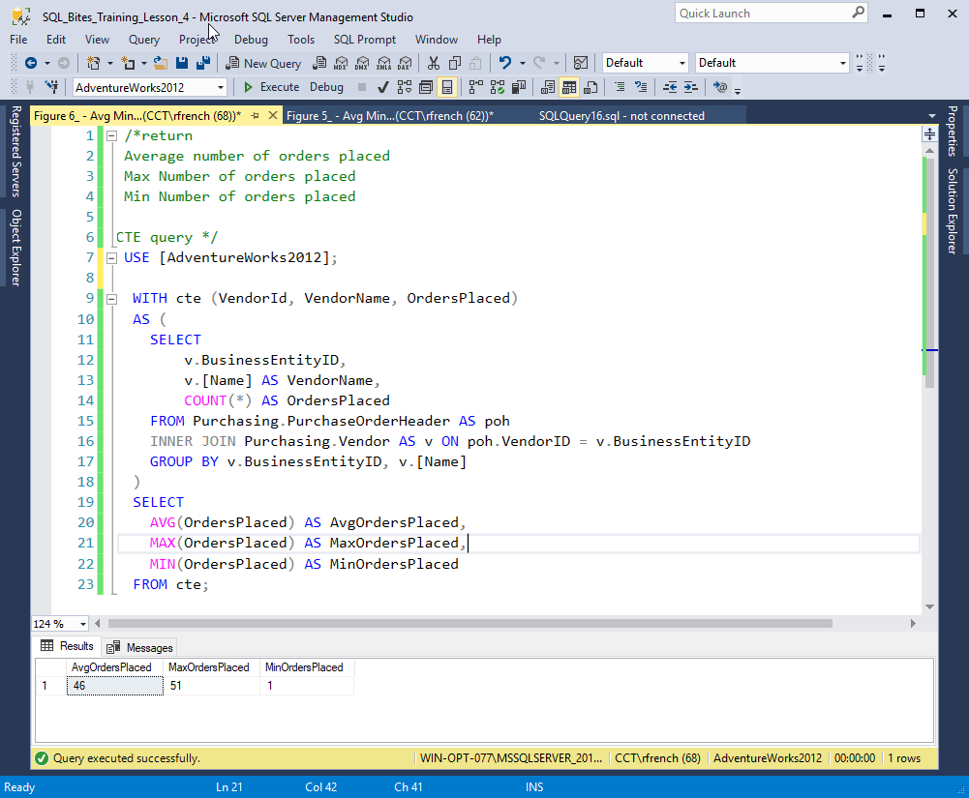
(Figure 5)
Notes:
https://facility9.com/2008/12/a-quick-introduction-to-common-table-expressions-3/

Slide 12
Question
What would need to change to filter by V.[PreferredVendorStatus]
Where = 1 or = 0

Slide 13
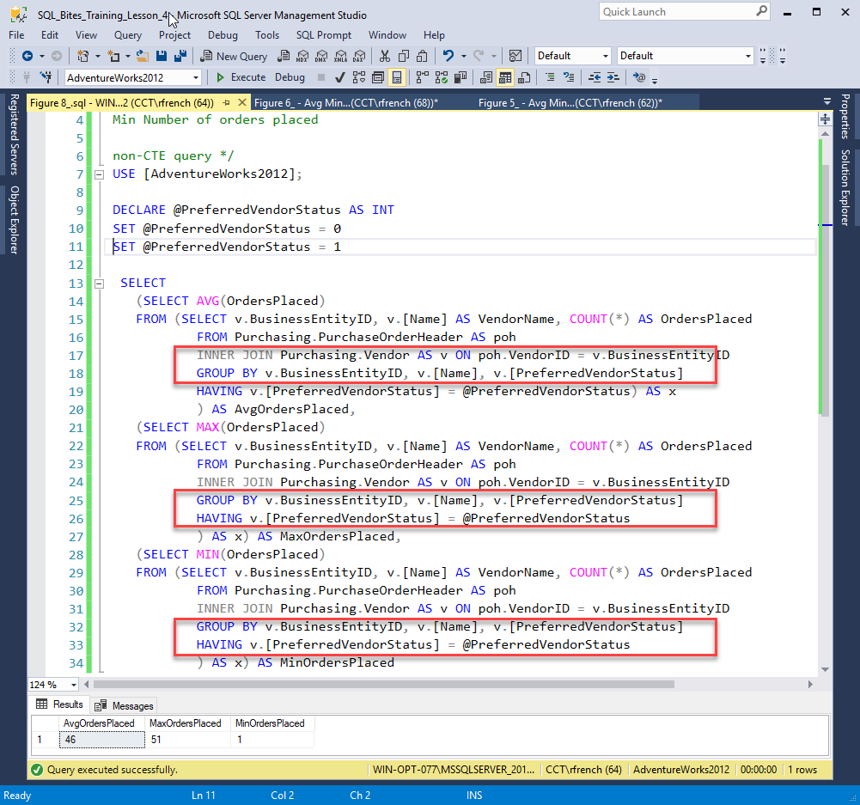
(Figure 6)

Slide 14
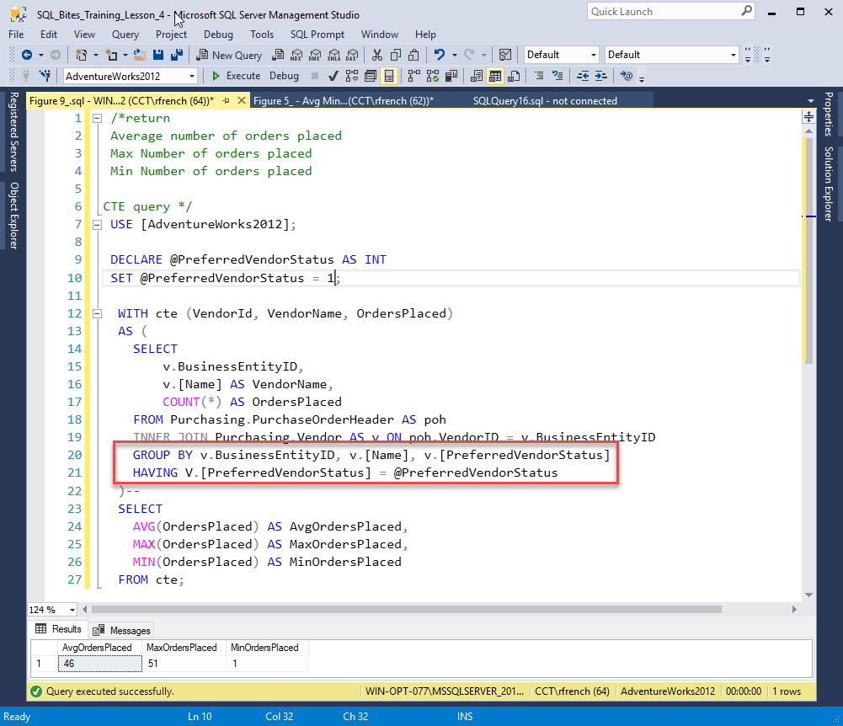
(Figure 7)

Slide 15


Slide 16


Slide 17


Slide 18
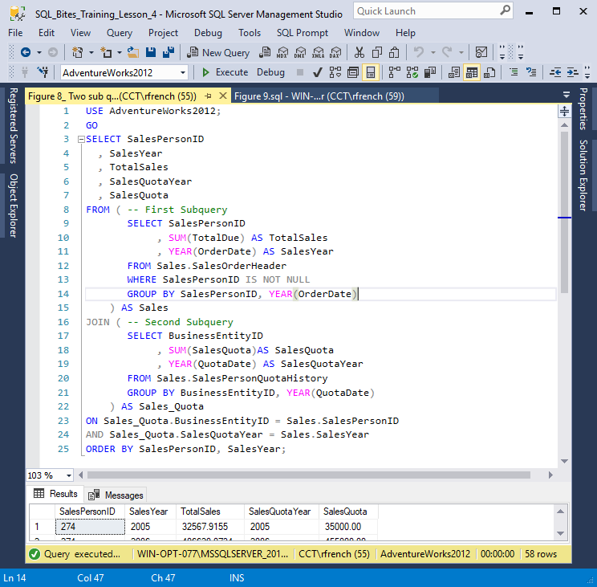
(Figure 8)

Slide 19
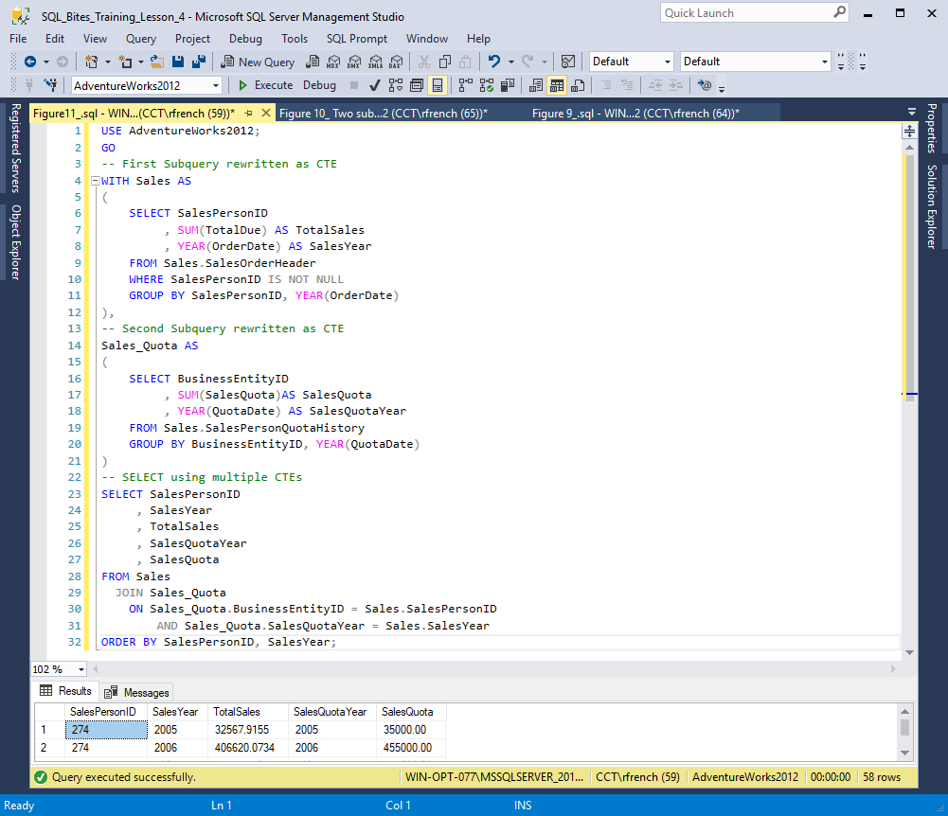
(Figure 9)
Notes:
http://www.sqlservercentral.com/articles/Stairway+Series/122606/

Slide 20


Slide 21
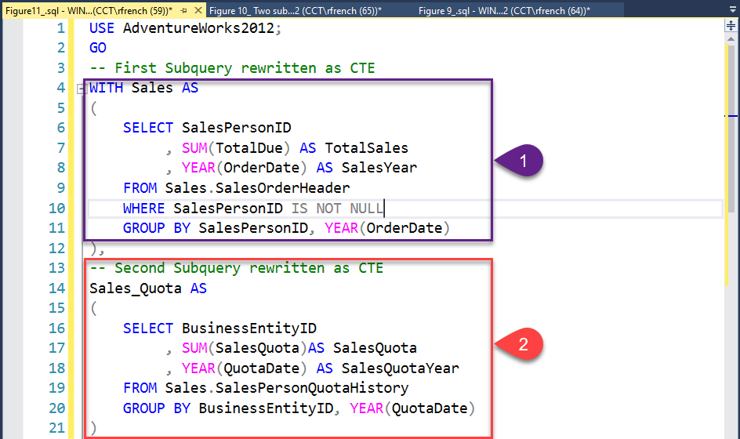

Slide 22
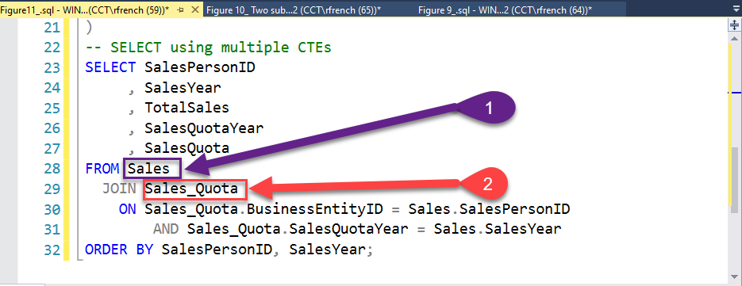

Slide 23
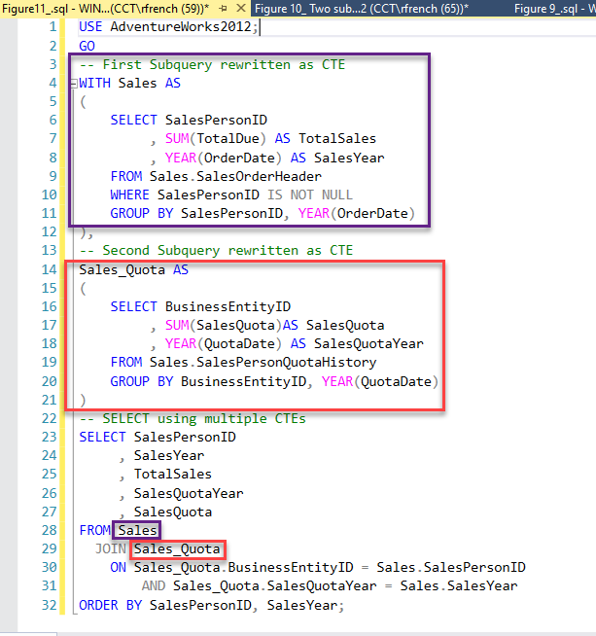

Slide 24


Slide 25
Update using CTE

Slide 26
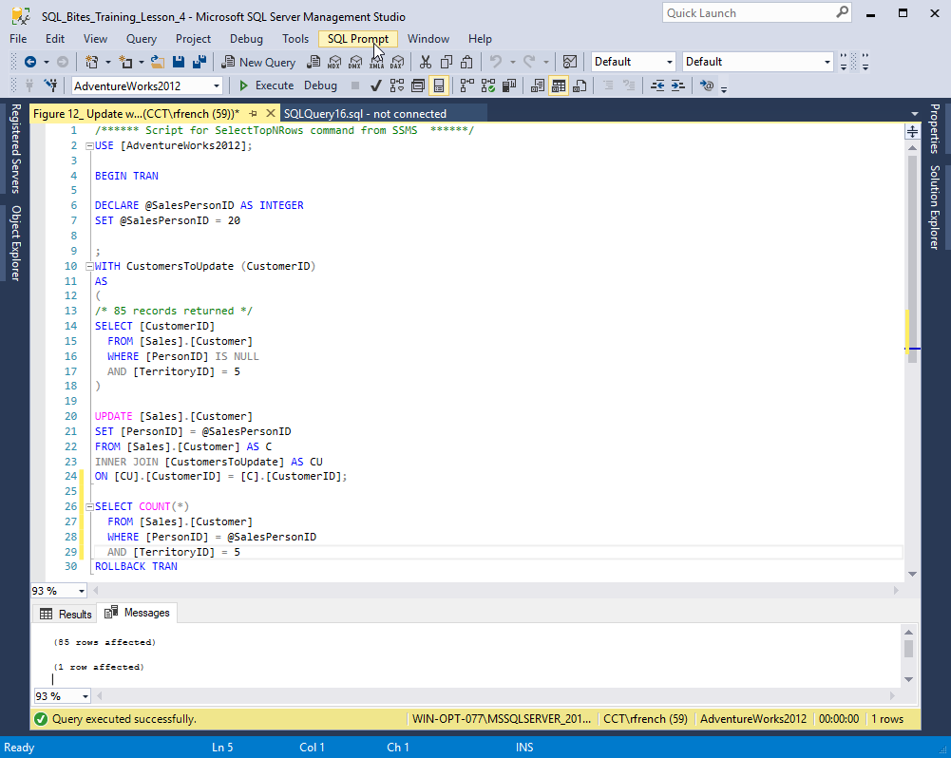
(Figure 10)

Slide 27
Delete using CTE

Slide 28
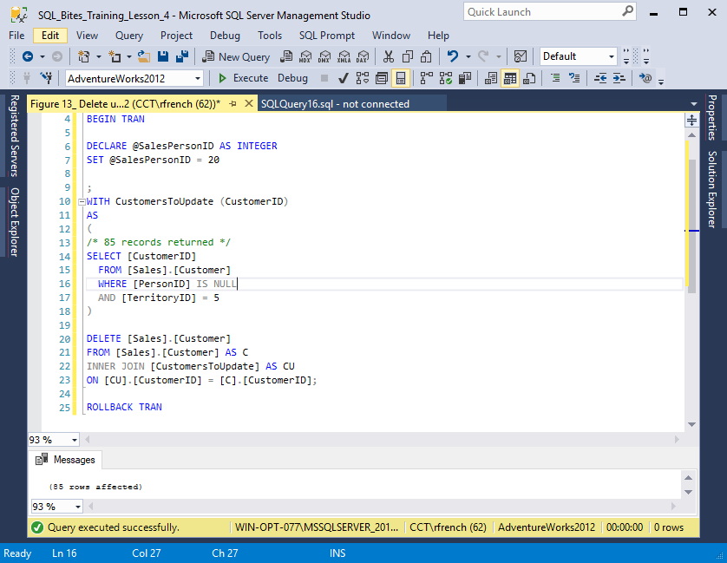
(Figure 11)

Slide 29
CTEs can also be used in
Views
Stored procedures
And many other objects

Slide 30
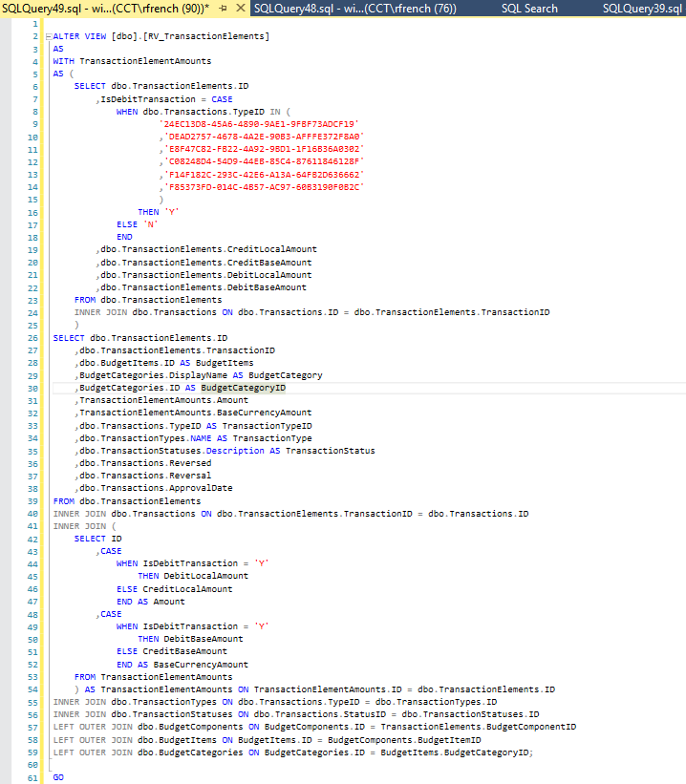
RV_TransactionElements

Slide 31

Recursion
A CTE can call itself

Slide 32
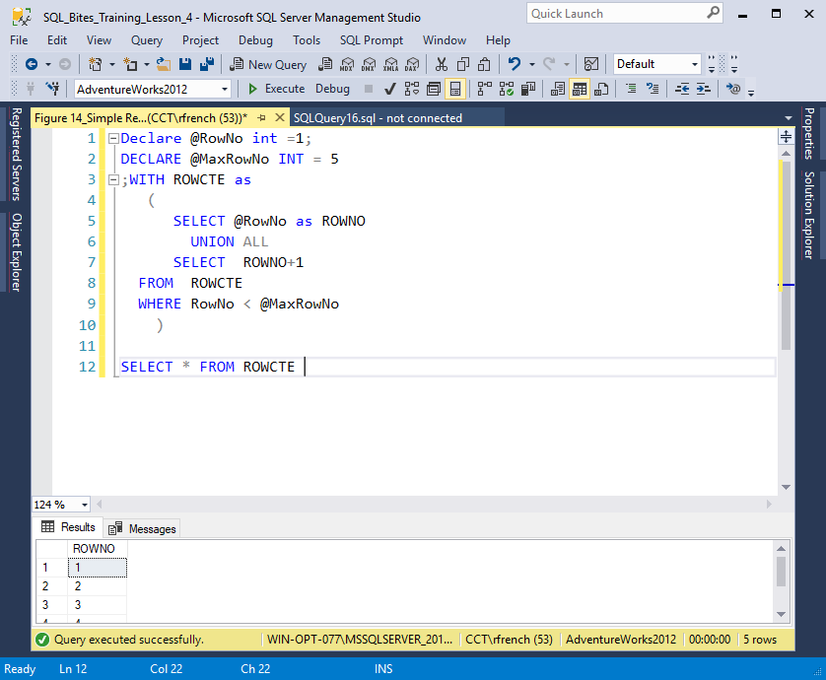
(Figure 12)

Slide 33


Slide 34
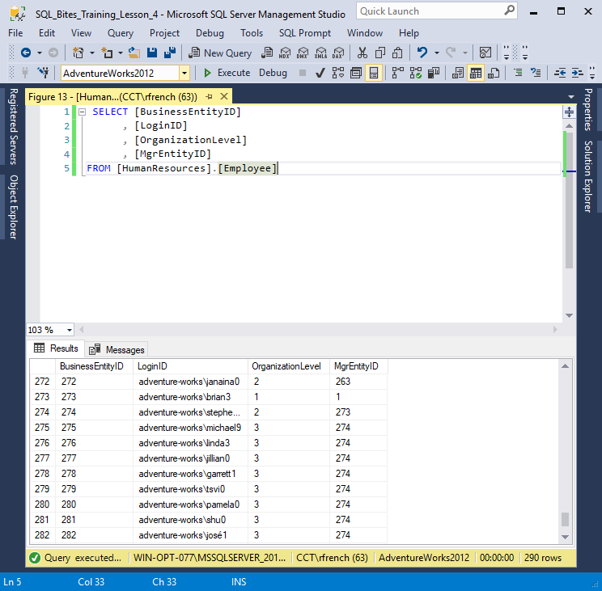
(Figure 13)

Slide 35
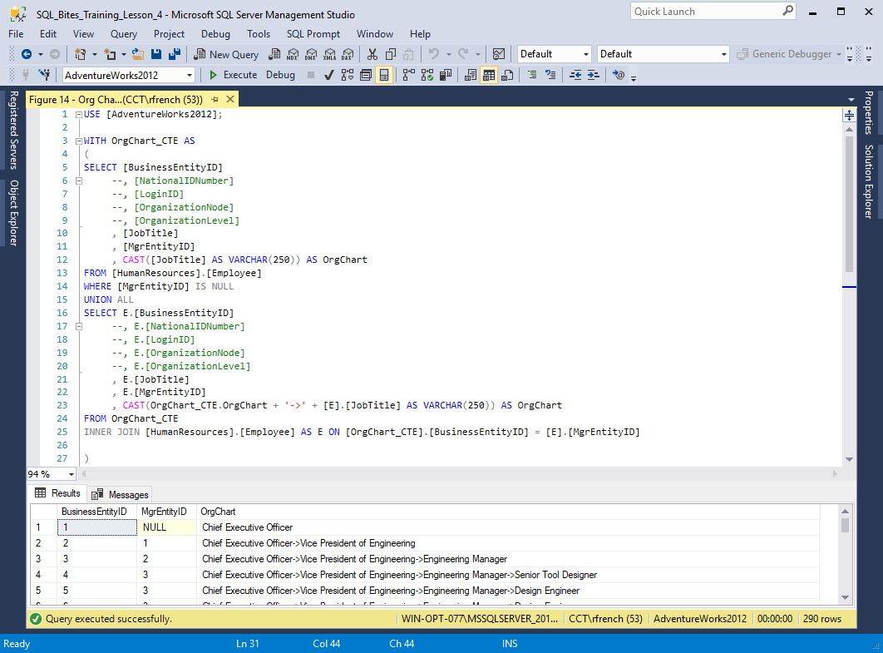
(Figure 14)

